Slide 1

Project Micro-Credit Defaulter Loan
Presented by: Akshay Shingavi

Slide 2
Summary
Introduction
Problem Statement
What is Microcredit Loan?
Need for Microcredit Loan
Exploratory Data Analysis (EDA)
Checking outliers
Correlation
Model Selection
Hyper Parameter Tuning
ROC and AUC
Saving Model
Conclusion

Slide 3
Introduction
One of the most crucial hazards for a financial organization to handle is credit defaulter risk. Since there is no profit without loan payback, the issue of credit defaulter risk management affects all financial organizations that lend to individuals and legal entities. This is especially true for microcredit businesses that simply offer loans as a product.
A microfinance institution (MFI) is a company that provides financial services to those with little resources. Targeting impoverished, unbanked families in rural locations with few sources of income makes MFS highly effective. Group Loans are a type of Microfinance Service (MFS) offered by MFI. Loans for agriculture, loans to certain businesses, etc.
The usage of mobile financial services (MFS), which many microfinance institutions (MFI), experts, and funders believe to be more cost-effective, easy, and efficient than the conventional high-touch strategy used for many years to offer microfinance services, is becoming increasingly popular. Although low-income households are the MFI industry's primary emphasis, and they are tremendously helpful in these communities, the implementation of MFS has been inconsistent, with both considerable obstacles and triumphs.

Slide 4
Problem Statement
A Microfinance Institution (MFI) is an organization that offers financial services to low-income populations. MFS becomes very useful when targeting especially the unbanked poor families living in remote areas with not many sources of income. The Microfinance services (MFS) provided by MFI are Group Loans, Agricultural Loans, Individual Business Loans, and so on.
Many microfinance institutions (MFI), experts, and donors are supporting the idea of using mobile financial services (MFS) which they feel are more convenient and efficient, and cost-saving, than the traditional high-touch model used for long for the purpose of delivering microfinance services. Though the MFI industry is primarily focusing on low-income families and is very useful in such areas, the implementation of MFS has been uneven with both significant challenges and successes.
Today, microfinance is widely accepted as a poverty-reduction tool, representing $70 billion in outstanding loans and a global outreach of 200 million clients.

Slide 5

What is Microcredit Loan?
Microcredit is a popular type of microfinance that entails a very modest loan given to a person to assist them in starting their own business or expanding an existing one. These borrowers typically have modest incomes, especially those from developing nations (LDCs).
Microcredit, which is often referred to as "microlending" or "microloans," strives to assist and support business owners who are unable to secure the funding they require to launch a small company or capitalize on an idea. Essentially, defaulting on a loan implies you've ceased paying payments on a loan or credit card in accordance with the conditions of the account. Generally speaking, missing a payment on a loan might harm your credit and jeopardize your overall financial security.

Slide 6
Need of Microcredit Loan
Due to their weak or nonexistent credit histories, loan providers find it challenging to grant loans to individuals. Because of this, some customers take advantage of the situation by default. Let's say you work for a consumer finance firm that specializes in providing urban consumers with different sorts of loans. To analyze the patterns found in the data, you must employ EDA. This will prevent the applicants from being turned down based on their ability to repay the loan.
When a loan application is received, the business must evaluate whether to approve the loan based on the applicant's profile. The bank's choice is accompanied by two different kinds of hazards.
If the applicant has a good chance of repaying the loan, refusing to approve it would cost the company business. If the borrower isn't likely to pay back the loan or is likely to default, then accepting the loan might result in a loss for the business.
Unprivileged individuals can access essential financial services including loans, insurance, and savings through microfinance firms. Families may fulfill their goals and pay for improvements to their houses, such as installing running water or power, by saving money. Entrepreneurs can launch or grow their micro, small, and medium-sized businesses thanks to modest loans. Medical care costs may be mitigated by insurance products.

Slide 7
Exploratory Data Analysis (EDA)
Importing the necessary libraries and the dataset as a data frame.
analyzed some statistical data, looking at things like shape, the existence of unique values, information, and where zero values were found.
In the hopes that they wouldn't eventually lead to skewness, several columns with more than 90% zero values were eliminated, and the dataset had no null values since I couldn't identify any missing values in it. Information about the Day, Month, and Year were retrieved from the date column.
The statistical analysis of the dataset revealed a lot of negative or incorrect figures. The absolute command was then used to convert them to positive numbers.
Visualization of the features using univariate and bivariate analysis Univariate analysis is the simplest type of data analysis. Univariate analysis is the simplest type of data analysis. Uni, which stands for "one," uses a single variable to represent the data. Bivariate analysis is a different type of data analysis.

Slide 8
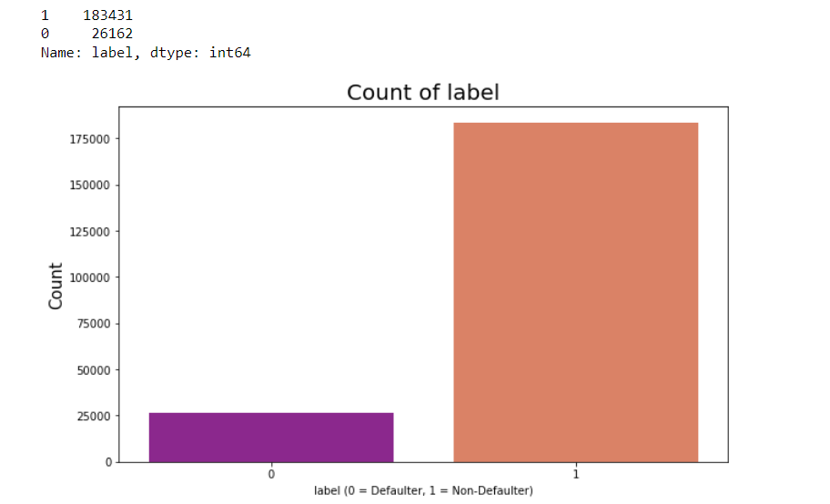
Univariate Analysis
Based on the above plots, we can see that 87% of the loans were paid in full by the user, while just 13% of them were not.
Additionally, the dataset is rather unbalanced, therefore we need to address that issue otherwise our model would be biased more in favor of success and provide incorrect results.

Slide 9
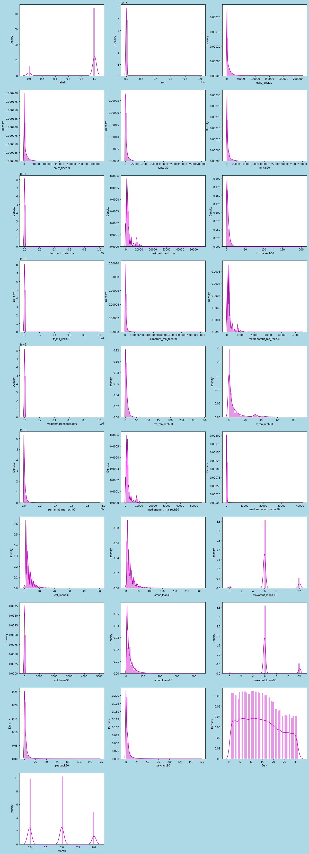
We can see from the distribution map above that most of the columns are not normally distributed, with the exception of the Day column, which is relatively normal. We need to reduce this skewness before creating our machine learning models since all the columns are skewed to the right and have a mean that is higher than the median.

Slide 10
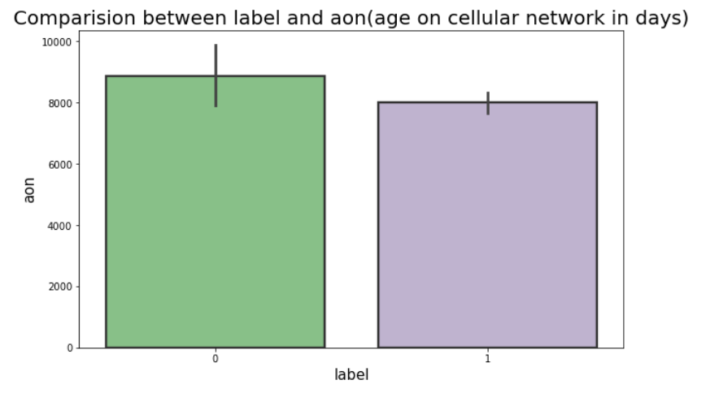
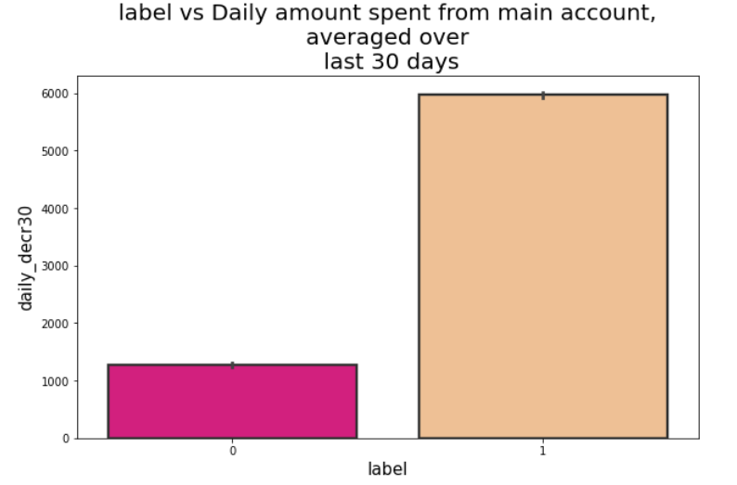
Bivariate Analysis
The above bar plot shows that the defaulter rate is greater where cellular network user ages in days are higher, with around 8871 counts (in days)
The majority of customers that returned the credit balance within 5 days after loan issuance have high rates of daily account activity over the past 30 and 90 days, with counts of roughly 5940 and 6732, respectively.

Slide 11
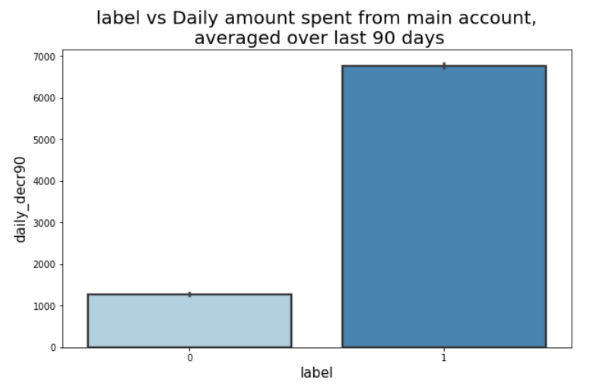
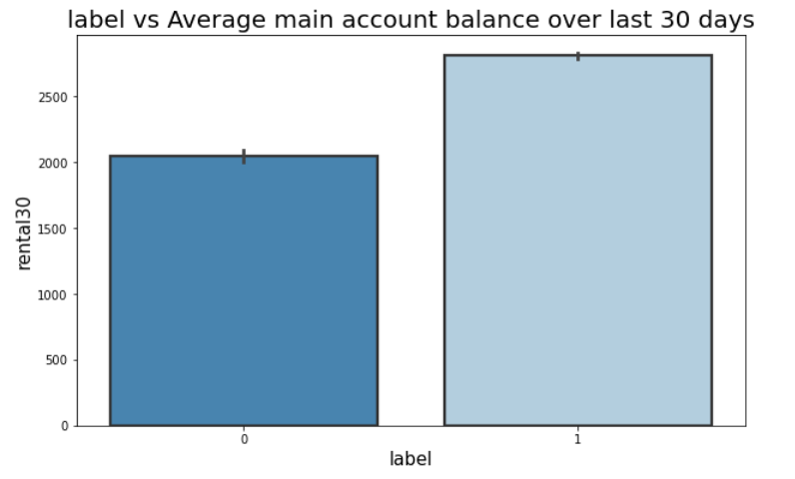
Bivariate Analysis
Around 0.6% of customers who have spent money from their primary account on a daily basis over the past 30 and 90 days have always paid back their loans in full within 5 days. In comparison to defaulters, non-defaulter users had an average primary account balance over the previous 30 and 90 days of roughly 2790 and 3640 respectively.

Slide 12
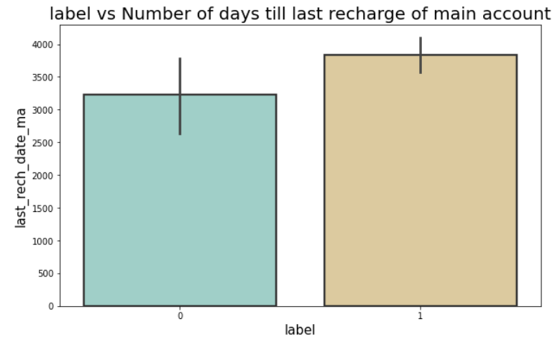
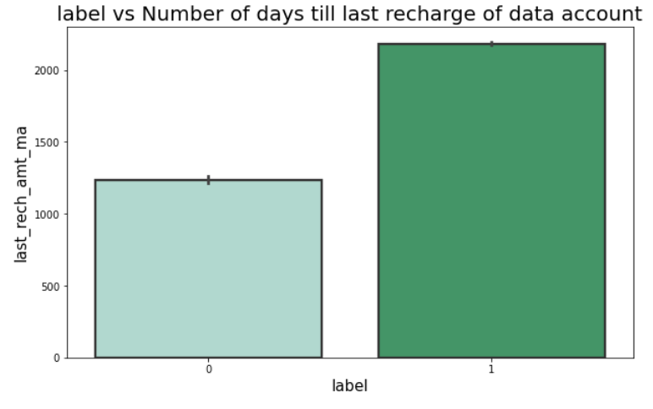
Bivariate Analysis
The individuals who have timely recharged their primary accounts are more likely to repay their loan within the allotted five days. Additionally, several customers who did not repay their loans within 5 days promptly recharged their primary accounts.
Looking at the last rech amt ma graphic above, we may infer that a higher proportion of borrowers will repay their loans if the primary account's most recent recharge was around 2000.

Slide 13
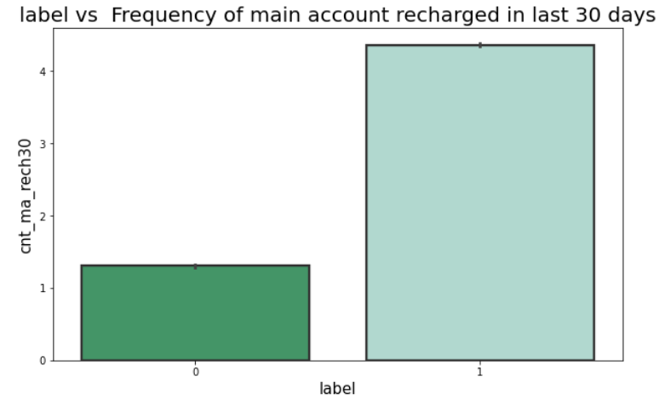
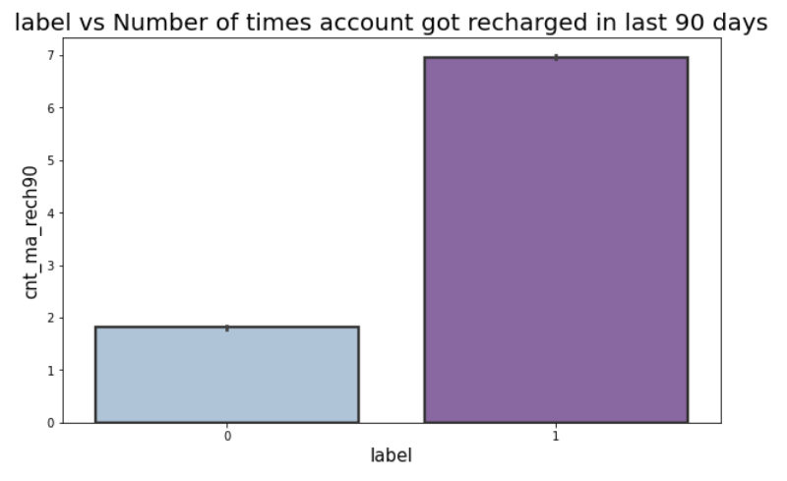
Bivariate Analysis
In the past 30 days, non-defaulters received more than four recharges on their main account, whereas defaulters only received one.
Customers who paid back their loans within five days received up to seven recharges to their main accounts in the previous ninety days, whereas users who did not get their loans by the due date received two recharges to their main accounts during the same period.
According to both plots, customers who had their primary account recharged a maximum of two times were better able to repay their loan in full within five days than those who had their main account refilled less frequently.

Slide 14
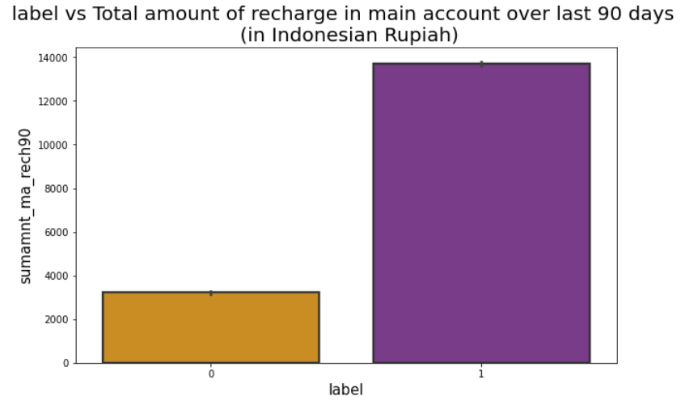
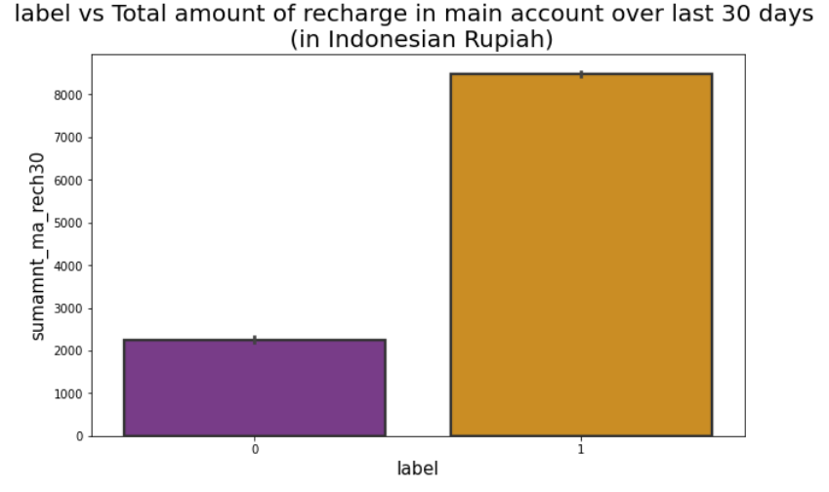
Bivariate Analysis
The individuals who didn't pay back the loan within 5 days have had about 2000–2400 fewer recharges in their primary account during the past 30 days (in Indonesian Rupiah). Additionally, those who paid off their loans in less than five days have recharged their primary accounts with more than 8000 (in Indonesian Rupiah) during the past thirty days.
Users who paid off their loan balance within five days had a total recharge in their primary account of roughly 13,700 Indonesian Rupiah over the previous ninety days, whereas defaulters had a total recharge of only 3,200 Indonesian Rupiah over the previous ninety days.

Slide 15
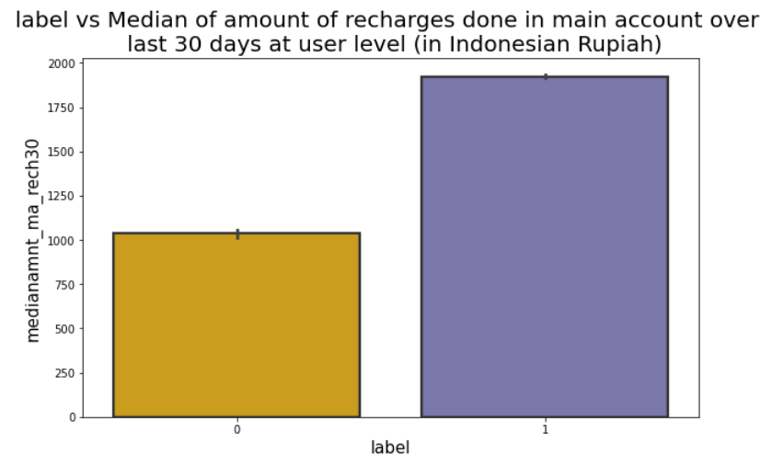
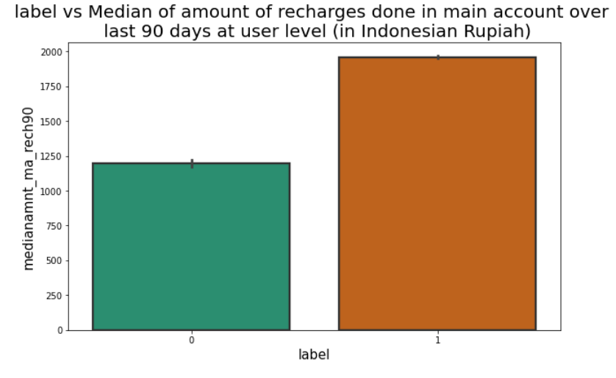
Bivariate Analysis
Users who have recharged their primary accounts with a median value of 1920 Indonesian Rupiah over the past 30 days have successfully repaid their credit amount within 5 days of receiving the loan, however, users who have recharged with a smaller amount—1036—have not been able to do so.
Similar to the statistics for the previous 30 days, consumers who have made a median recharge of 1950 in their primary account during the past 90 days have paid back their credit amount within 5 days, whereas users who have made a median loan payment of 1198 have not.

Slide 16
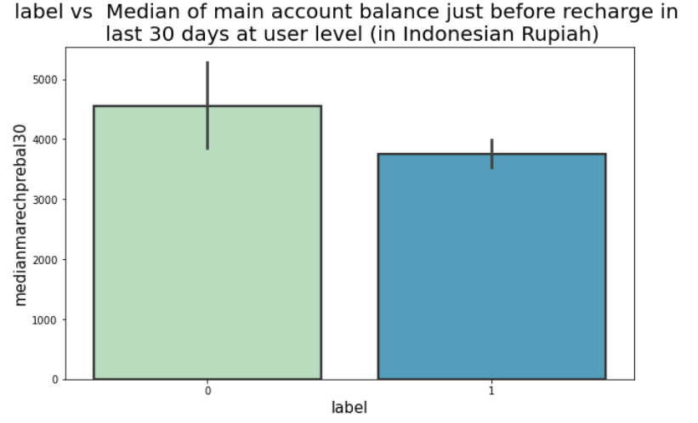
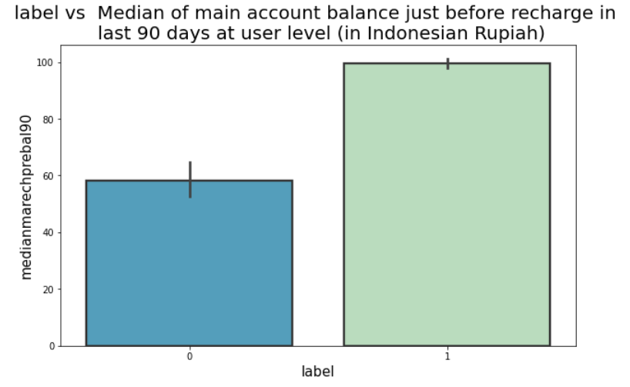
Bivariate Analysis
According to 30 days of data, defaulters' median main account balances are around 4500 (Indonesian Rupiah), which is higher than it is for non-defaulters. This means that, at the user level, the median main account balance has increased just before recharge in the past 30 days, increasing the likelihood that the user will be a defaulter.
The median main account value at the user level increased immediately before recharging in the last 90 days, boosting the likelihood of being a non-defaulter. In the past 90 days, the median main account balance for non-defaulters was roughly 100 (Indonesian Rupiah), which is high compared to defaulters.

Slide 17
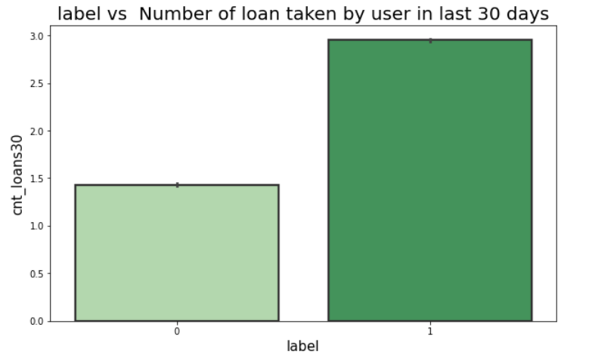
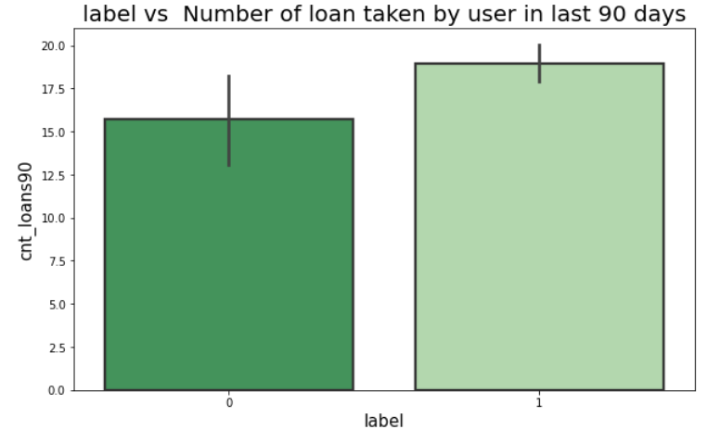
Bivariate Analysis
Defaulters have taken 1 loan in the past 30 days, meaning that they have a greater probability of not repaying the credit amount if they take out a loan just once in that time frame. Users who have paid back their loans have taken a maximum of 3 loans in the past 30 days, according to the data.
When compared to the previous 30 days' data, the number of loans taken by defaulters has increased significantly during the past 90 days, which also raises the likelihood that they would also default.

Slide 18
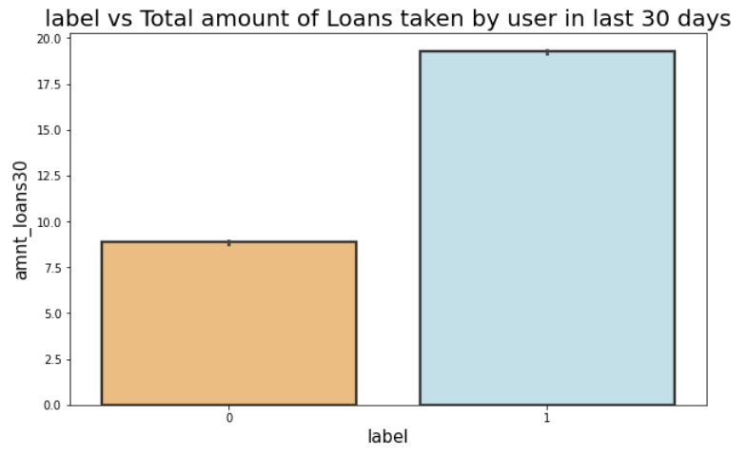
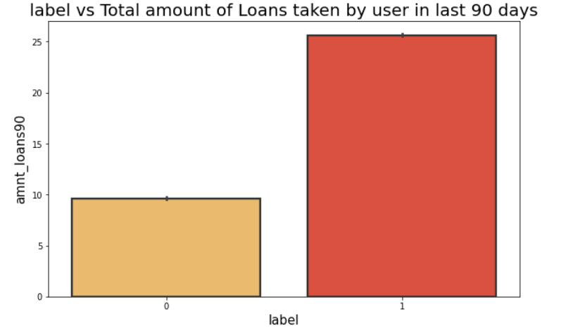
Bivariate Analysis
While non-defaulters have taken up to 20 loans in the previous 30 days, defaulters have taken a total of 7.5 to 10 loans during that time.
The overall number of loans taken in the previous 90 days by defaulters is up to 10, while the total number of loans taken in the same period by non-defaulters is up to 26.
The likelihood of defaulting on a loan is therefore high when the total number of loans taken by users over the course of the previous 90 days is less than 10.

Slide 19
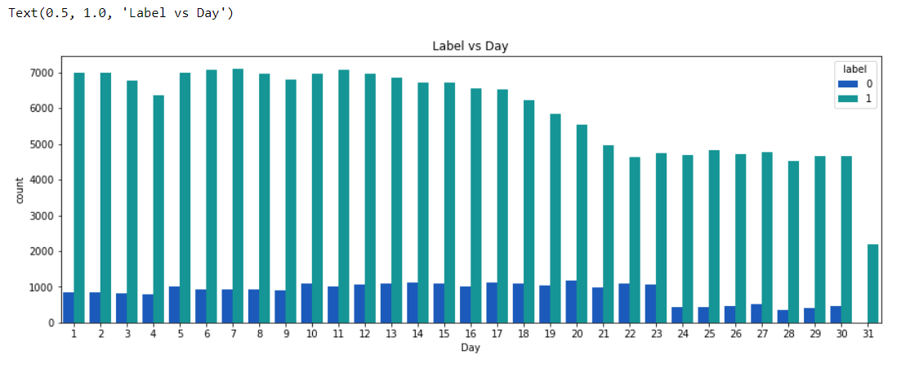
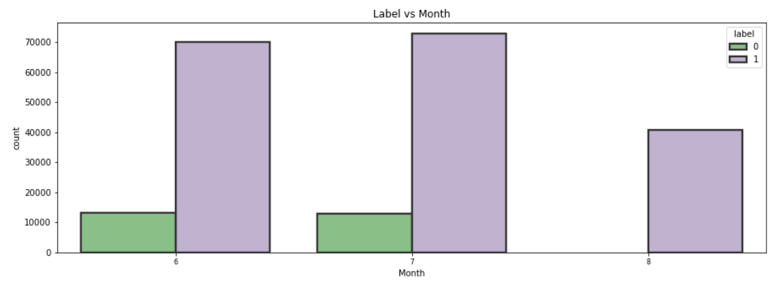
Bivariate Analysis
Users who took out loans throughout the month of August appear to be repaying them within 5 days.

Slide 20
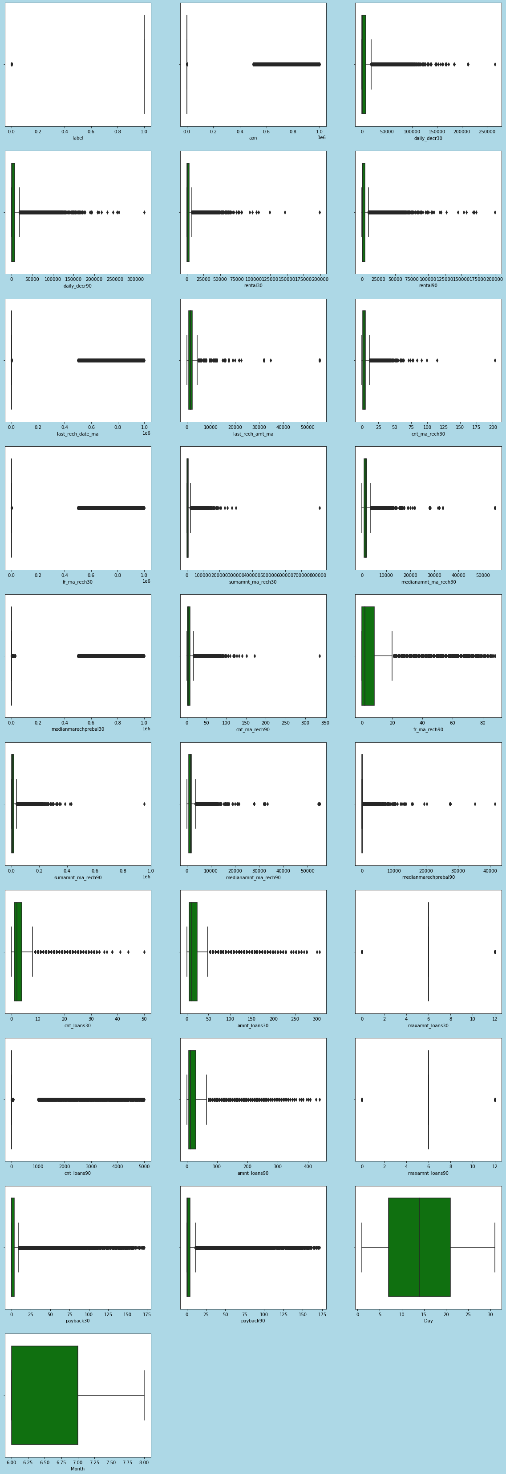
Checking outliers
With the exception of the Day and Month columns, all of the features in the boxplot shown above include outliers.
Except for Day, Month, and label, let's delete the outliers from these columns. Since label is our goal column, eliminating outliers from this column shouldn't result in any data loss.

Slide 21
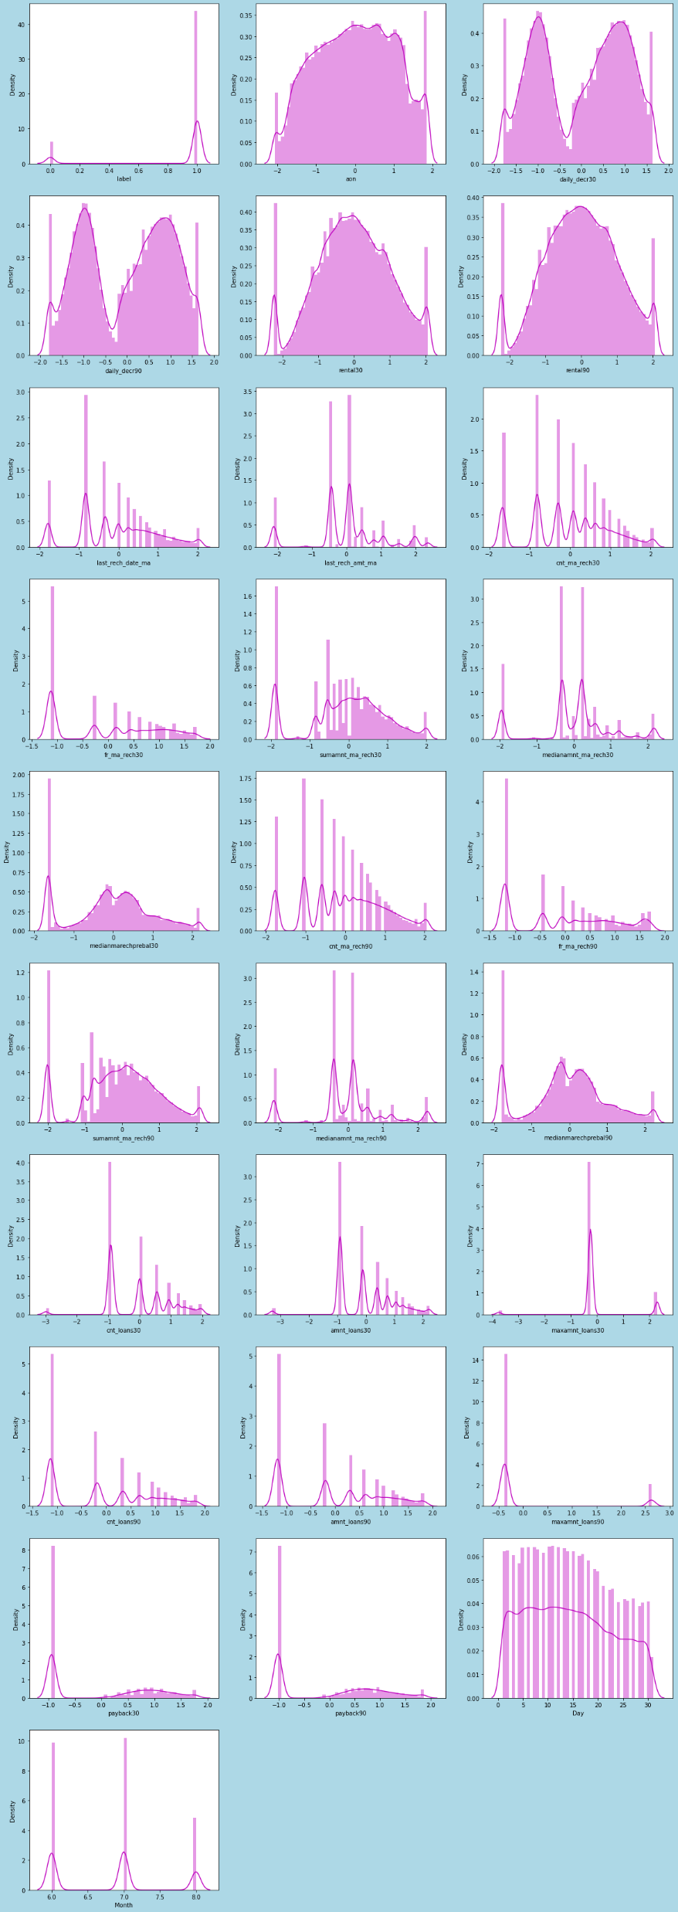
Checking skewness
We can observe the skewness has almost been reduced in all the columns. From the above dist plots we can see that the data has been distributed normally in some of the columns and the skewness is also reduced compared to the previous data.

Slide 22
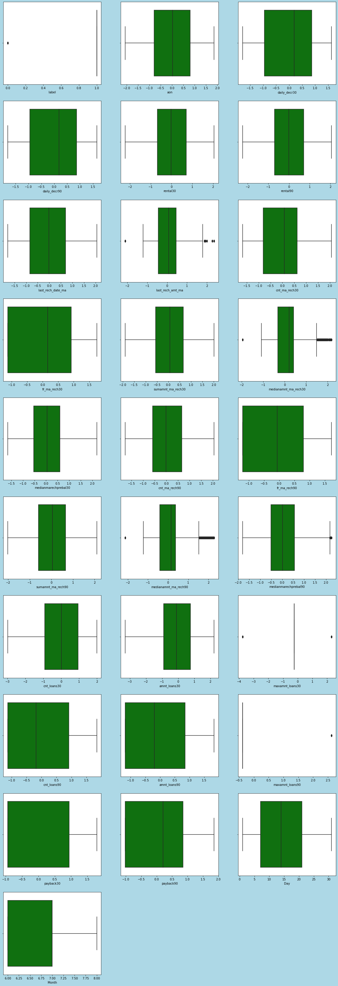
Checking outliers after removing skewness and outliers
It's encouraging to observe that, following the use of the percentile approach and the removal of skewness, the outliers are nearly eliminated in many columns.
Following data cleaning, the whole dataset included solely numerical data. There is no need to encrypt the data because the dataset's characteristics are purely numerical.

Slide 23
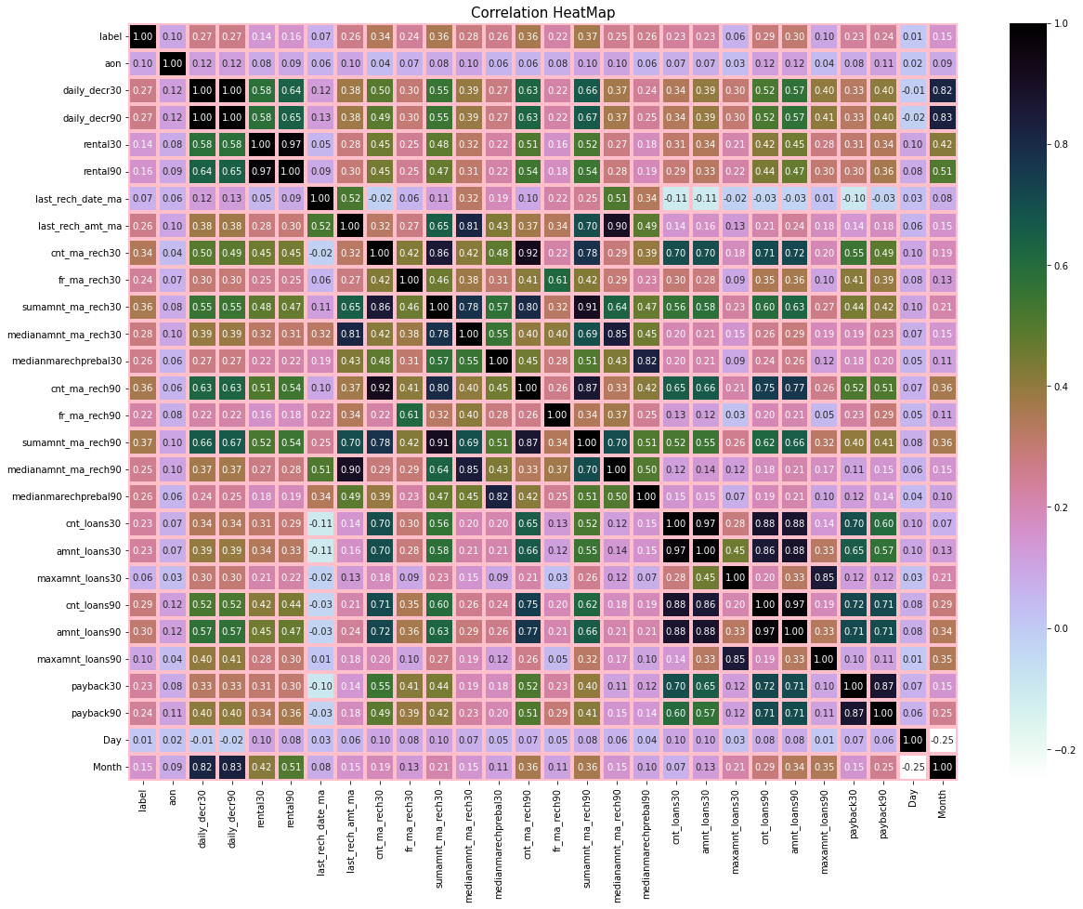
Correlation
This heat map displays the data's correlation matrix.
We can see how certain features relate to one another as well as how certain traits related to labels.
We can see that the relationship between the characteristics and the label in this case is weak.
The label has a strong positive correlation with dark colors and a strong negative correlation with light shades.
sumamnt ma rech30: The total recharge in the primary account during the last 30 days (in Indonesian Rupiah)
sumamnt ma rech90 : Total recharges made to the primary account during the last 90 days (in Indonesian Rupiah)
daily decr30: Average daily main account spending over the previous 30 days (in Indonesian Rupiah)
daily decr90: Average daily main account spending over the previous 90 days (in Indonesian Rupiah)
cnt ma rech30: number of main account recharges over the course of the previous 30 days
cnt ma rech90: The quantity of main account recharges during the previous 90 days.
Number of loans taken by the user in the past 30 days and the past 90 days, respectively.
Total amount of loans taken by user during the past 30 and 90 days, respectively.
The label of defaulters and non-defaulters data has a somewhat good connection with these characteristics. Additionally,
We can see that there is no inverse relationship between the label and the characteristics. The majority of the characteristics are connected to one another.

Slide 24
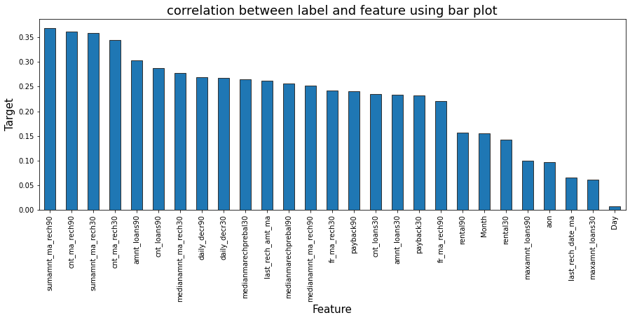
Checking correlation of all features with label
The bar plot makes it easy to see how positively correlated the label and characteristics are. In this case, Day's correlation with the table is lower than it is in other cases. If required, we can remove these columns, but for the time being, let's leave them in.

Slide 25
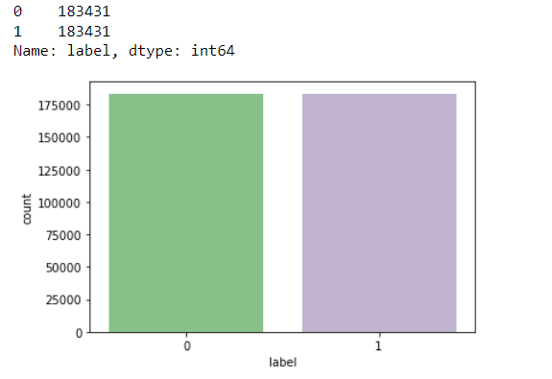
Oversampling of Data
Let's utilize the oversampling approach to balance the data as we have a problem with a class imbalance in our datasets.
We can now see that our data is balanced. Following the use of oversampling, we are once more showing the values in our label column to cross-verify the revised data. Here, we see that the issue of class imbalance has been effectively rectified, and since all the categories now have the same data, the machine learning model is not biased toward any one category.

Slide 26
Model Selection
Classification problem
Our best model will be selected from below.
DecisionTreeClassifier
RandomForestClassifier
ExtraTreesClassifier
GradientBoostingClassifier
BaggingClassifier

Slide 27
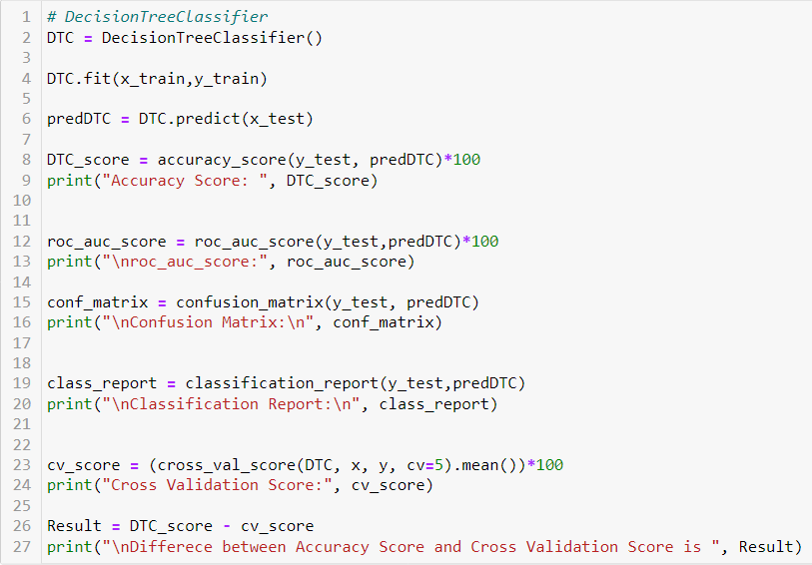
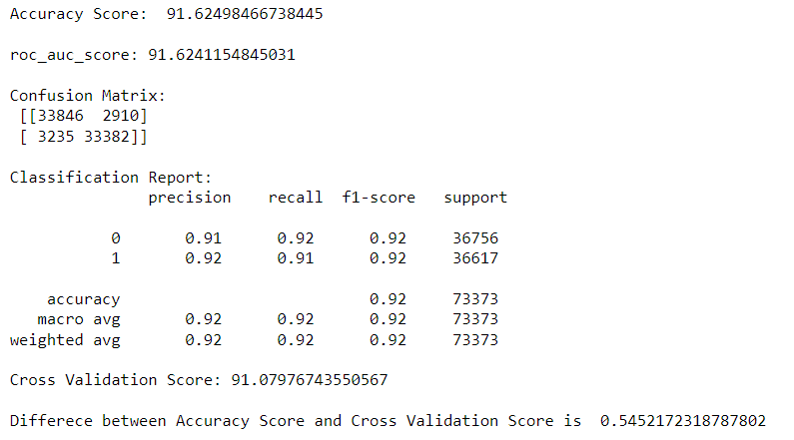
DecisionTreeClassifier
The accuracy of the newly created Decision Tree Classifier model, as determined by its assessment measures, is 91.62. The score or Cross Validation: 91.07. There is a 0.54 difference between the accuracy score and the cross-validation-validation score.

Slide 28
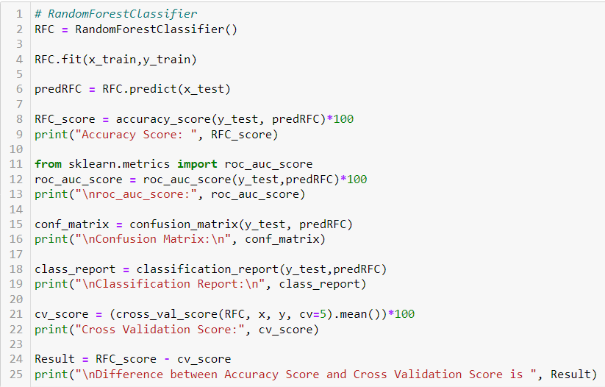
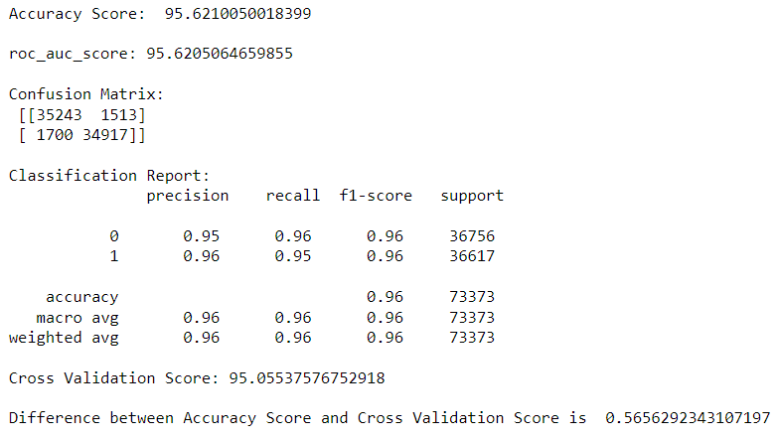
RandomForestClassifier
The accuracy of the newly created Random Forest Classifier model, as determined by its assessment measures, is 95.62. The score or Cross Validation: is 95.05. There is a 0.56 difference between the accuracy score and the cross-validation-validation score.

Slide 29
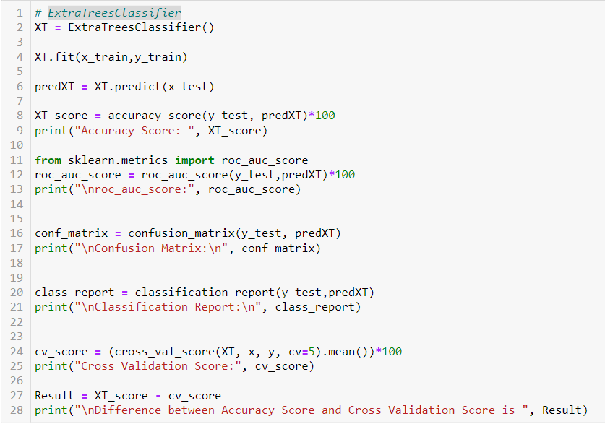
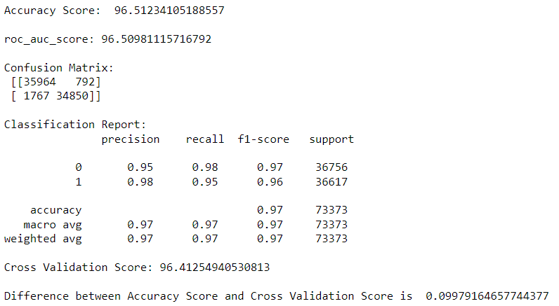
ExtraTreesClassifier
The accuracy of the newly created ExtraTreesClassifier model, as determined by its assessment measures, is 96.51. The score or Cross Validation: is 96.41. There is a 0.099 difference between the accuracy score and the cross-validation-validation score.

Slide 30
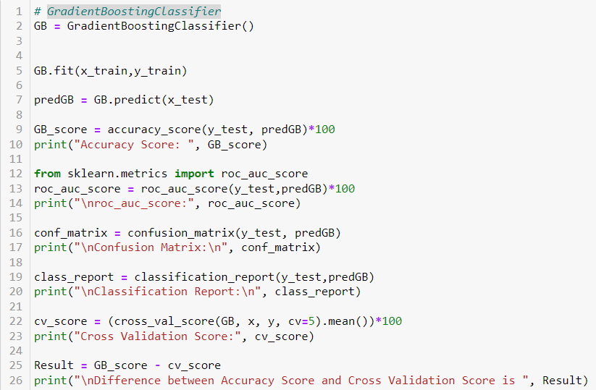
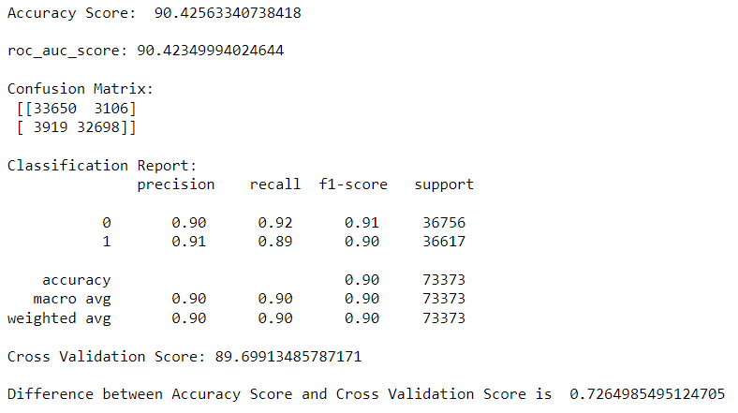
GradientBoostingClassifier
The accuracy of the newly created Gradient Boosting Classifier model, as determined by its assessment measures, is 90.42. The score or Cross Validation: is 89.69. There is a 0.72 difference between the accuracy score and the cross-validation-validation score.

Slide 31
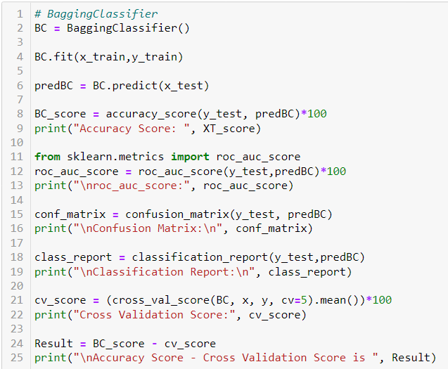
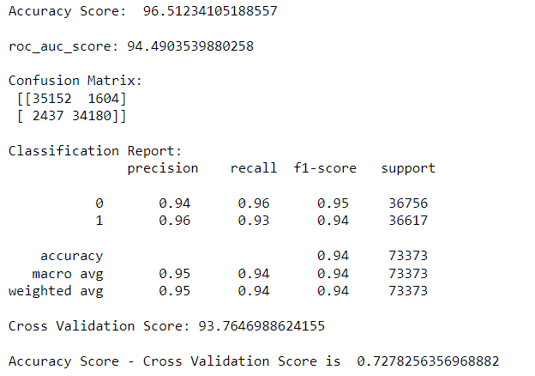
BaggingClassifier
The accuracy of the newly created Bagging Classifier model, as determined by its assessment measures, is 96.51. The score or Cross Validation: is 93.74. There is a 3 approx. difference between the accuracy score and the cross-validation-validation score.

Slide 32
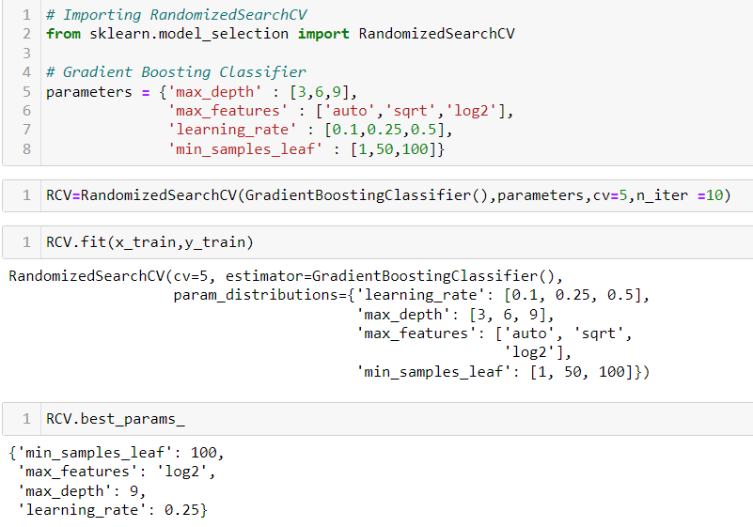
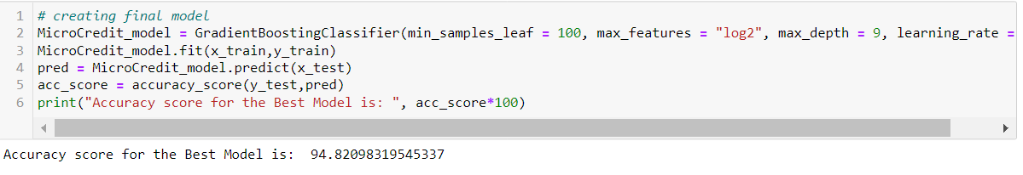
Hyper Parameter Tuning
Gradient Boosting Classifier has the least deviation from accuracy and cross-validation score when compared to other models. We may thus draw the conclusion that Gradient Boosting Classifier, which is our best-fitting model, underwent Hyper Parameter Tuning to improve the best model accuracy. The accuracy Score for this is now 94.82.

Slide 33
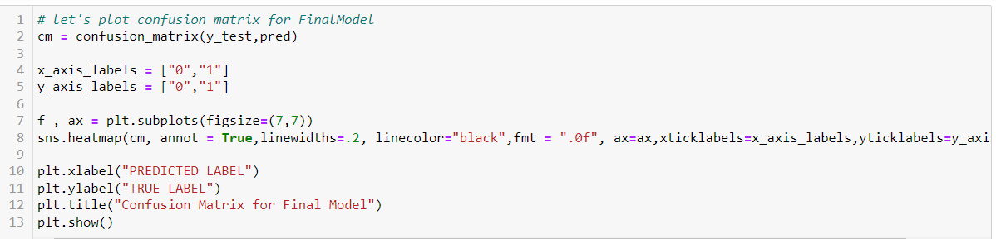
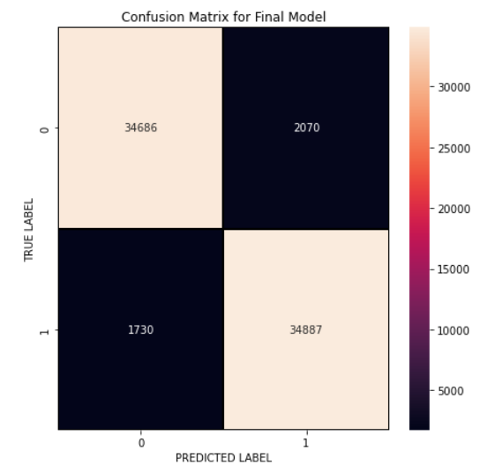
Confusion Matrix
We may view actual and anticipated values for the final model with the aid of the confusion matrix. Additionally, we can see how frequently we received accurate results and how frequently my model failed to make the right forecast.

Slide 34
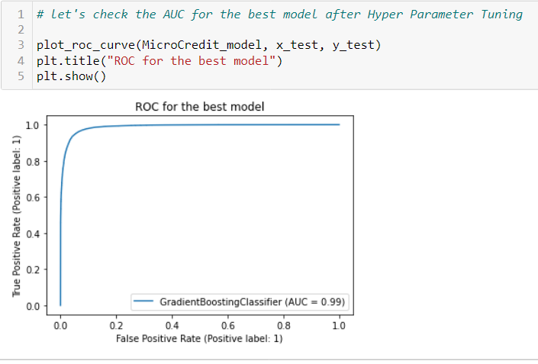
Plotting ROC and Compare AUC for the Final Model
I produced the ROC Curve for each model, selected the best model, and compared it to the AUC. As seen from the curves, my final model has an AUC score of 99%, which goes up once the model is tuned.

Slide 35
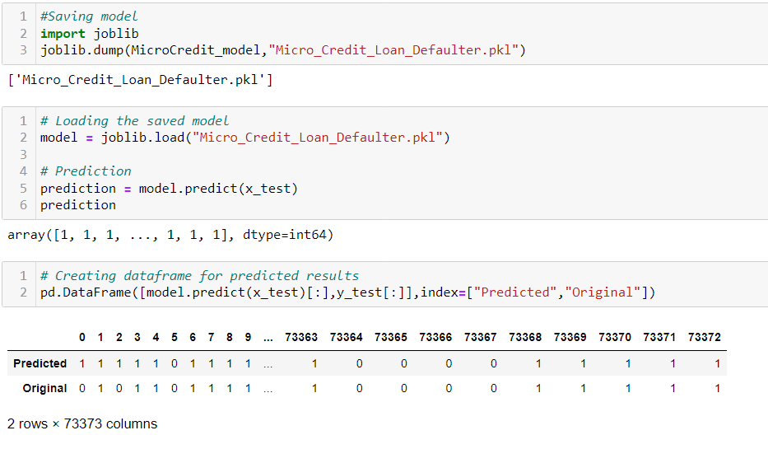
Saving The Model
I loaded the stored model for predictions after using the joblib library to save my best model in. pkl format.
We obtained the expected values for microcredit loans for defaulters and non-defaulters using the classification model. We can see from the forecasts that the actual and expected numbers are almost identical.

Slide 36
Conclusion
This case study intends to provide an example of how EDA may be used in a real-world corporate setting. Along with using the skills we gained in the EDA module, we will gain a fundamental grasp of risk analytics in banking and financial services in this case study. We will also discover how data is utilized to reduce the risk of losing money when lending to consumers.
We were able to deduce from this information that multiple criteria are used to choose consumers for credit in order to determine whether they are defaulters or not.
We loaded the dataset first, followed by data cleaning, an EDA procedure, and pre-processing techniques including scaling data, testing for outliers, skewness, and correlation.
After that, we built a model, trained it, and evaluated it using a variety of metrics, including accuracy score, cross-validation score, roc-auc score, f1 score, and others. The Random Forest Classifier, Decision Tree Classifier, Extra Trees Classifier, Gradient Boosting Classifier, Bagging Classifier, and other ensemble approaches were tested.

